Slide 1
TERM DEPOSIT
PREDICTION
FINAL PROJECT JCDS BEKASI
SRI ASTUTI HERYANTI

Slide 2
BACKGROUND PROJECT
In this project, we apply machine learning algorithms to build a predictive model of the dataset in order to provide a necessary suggestion for the marketing campaign team. This will help in reducing the cost of marketing thus increasing the revenue of the bank.
Financial institutions example like Banks generate their revenue through lending and borrowing . Lending generates profits in for of interest from customers but some level of risk is involved, that is why machine learning algorithms come in handy in predicting clients who are eligible for loans. Another form that generates revenue for financial institutions is borrowing or attracting public savings into the bank which is a bit less risky than lending. Borrowing works this: the bank invests the client’s long term deposits into other sectors which brings better returns, where some is payed to the customers. However when a client does fixed-term deposit, the company gets good returns than savings account as the customer or the client is deprived off the rights to access the money prior to the maturity unless the client is ready to compensate the bank.
Due to this reason, there is a stiff competition between banks to convince clients to do term deposits in their banks, and due to this marketing campaigns, a huge amount of money is spent by the banks in reaching out to clients, prospective open and non-prospective ones since the bank doesn’t know who is and who is not. With advancement in data science and machine learning and availability of data, the banks are adapting to data-driven decisions and this will help in reducing the cost of marketing thus increasing the revenue of the bank.
In this project, we apply machine learning algorithms to build a predictive model of the dataset in order to provide a necessary suggestion for the marketing campaign team. The goal is to predict whether a client will open a term deposit or not.

Slide 3
OBJECTIVE PROJECT
Business Goal
Reducing marketing resources by identifying customers who would open to term deposit and thereby direct marketing efforts to them.
Analysis Goal
Fitting the possible set of models that will predict which set of customers are best for directing marketing campaign to them. This would help the marketing campaign team of Portuguese bank to develop their strategy in telemarketing their term deposit scheme.

Slide 4
STEP OF PROJECT
Evaluate model to find the best model
Best
Model
Apply machine learning to data with classification modeling
Create datasets for training the model and split into train and test datasets
Optimize Model
Machine Learning
Do EDA and statistical test for the data
Split
Data
TERM DEPOSIT PREDICTION
Explore Data

Slide 5
Data Description
Age
Marital
Default
How old the customer is?
Which marital status customer include?
The customer has credit in default?
Job
Education
Housing
What is job of the customer?
Which education status customer include?
The customer has housing loan?

Slide 6
DATA DESCRIPTION
Loan
Contact
Day
The customer has personal loan?
Which the customer contact communication type?
When the customer last contact day of month?
Balance
Month
Duration
How many balance of the customer
When the customer last contact month of year?
How many the customer last contact duration, in seconds

Slide 7
DATA DESCRIPTION
Campaign
Previous
Deposit
How many the customer number of contacts performed during this campaign?
How many the customer number of contacts performed before this campaign
Has the customer is potential open a term deposit
Pdays
Poutcome
How many the customer number of days that passed by after was last contacted from a previous campaign
Which the customer outcome of the previous marketing campaign

Slide 8
EXPLORE DATA
Find Missing Value and Outlier
Performs search and handling of missing values ​​and outliers on the data
Data Visualization
Make data to diagrams for get more insight about the data
Statistical Test
Perform statistical tests on the data

Slide 9
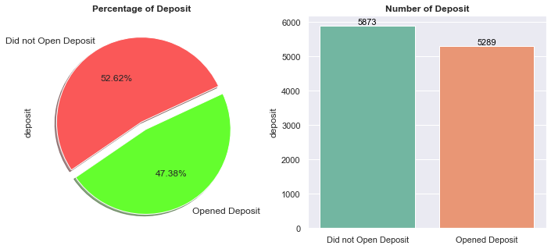
DATA VISUALIZATION
Based on the data beside, it can be seen that the number and percentage that opened the deposit

Slide 10
MACHINE LEARNING
Logistic Regression
Decision Tree Classifier
Logistic Regression is a Machine Learning classification algorithm that is used to predict the probability of a categorical dependent variable. In logistic regression, the dependent variable is a binary variable that contains data coded as 1 (yes, success, etc.) or 0 (no, failure, etc.)
Decision Tree is one of the easiest and popular classification algorithms to understand and interpret.
Decision Tree consists of :
Nodes
Edges/ Branch
Leaf nodes
L
D
Random Forest Classifier
R
G
Gradient Boost Classifier
Random Forest algorithm is a supervised classification algorithm. We can see it from its name, which is to create a forest by some way and make it random. There is a direct relationship between the number of trees in the forest and the results it can get the larger the number of trees, the more accurate the result.
Gradient boosting is a machine learning technique for regression and classification problems, which produces a prediction model in the form of an ensemble of weak prediction models, typically decision trees.

Slide 11
OPTIMIZE MODEL
Hyperparameter Tuning
Choose Random Search Cross Validation

Slide 12
OPTIMIZE MODEL
Random Over Sampler
Random Under Sampler
RESAMPLING
SMOTE

Slide 13
BEST MODEL
Accuracy Score
0.79
After optimizing the model, the logistic regression is selected as the best model with an accuracy score is 0.79
F1 Score
0.77
After optimizing the model, the logistic regression is selected as the best model with a F1 score is 0.77
Precision Positive
0.80
After optimizing the model, the logistic regression is selected as the best model with a precision negative score is 0.80
Recall Negative
0.83
After optimizing the model, the logistic regression is selected as the best model with a recall positive score is 0.83

Slide 14
The marketing can identify the potential client by using the model if the client’s information like education, housing loan, personal loan, duration of the call, number of contacts performed during this campaign, previous outcomes, etc is available. This will help in minimizing the cost to the bank by avoiding to call customers who are unlikely to subscribe the term deposit. They can run a more successful telemarketing campaign using this model.
The results are impressive and convincing in terms of using a machine learning algorithm to decide on the marketing campaign of the bank. Almost all of the attributes contribute significantly to the building of a predictive model. Among the four classification approach used to model the data, the Logistic Regression. Based on the pair plot, it is known that each feature in dataset has almost similar characteristics to determine the prediction class
Business
Analysis

Slide 15
THANK YOU

